Slide 1
VLSI Architecture Labs
Arnav Geet Verma
2022A3ps0430p

Slide 2
Lab 1
Basics of Verilog HDL
Task is to test functions of each Verilog operator and display its results
Tests performed:
Arithmetic Operators
Logical Operators
Bitwise Operators
Reduction Operators
Shift Operators
Relational, Equality Operators
Concatenation and Repetition Operators

Slide 3
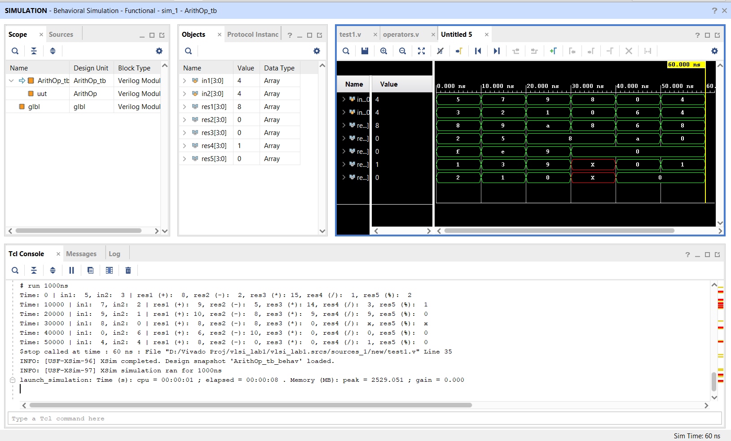
Results-Arithmetic

Slide 4
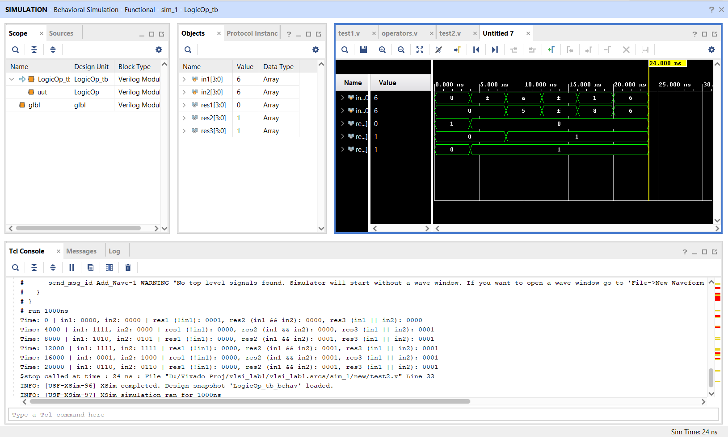
Results-Logical

Slide 5
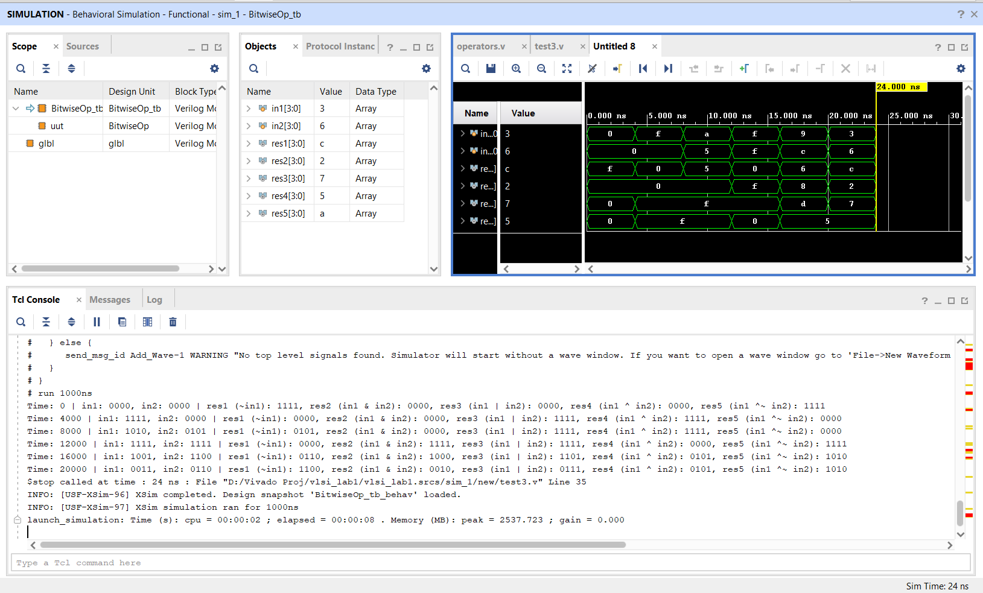
Results-Bitwise

Slide 6
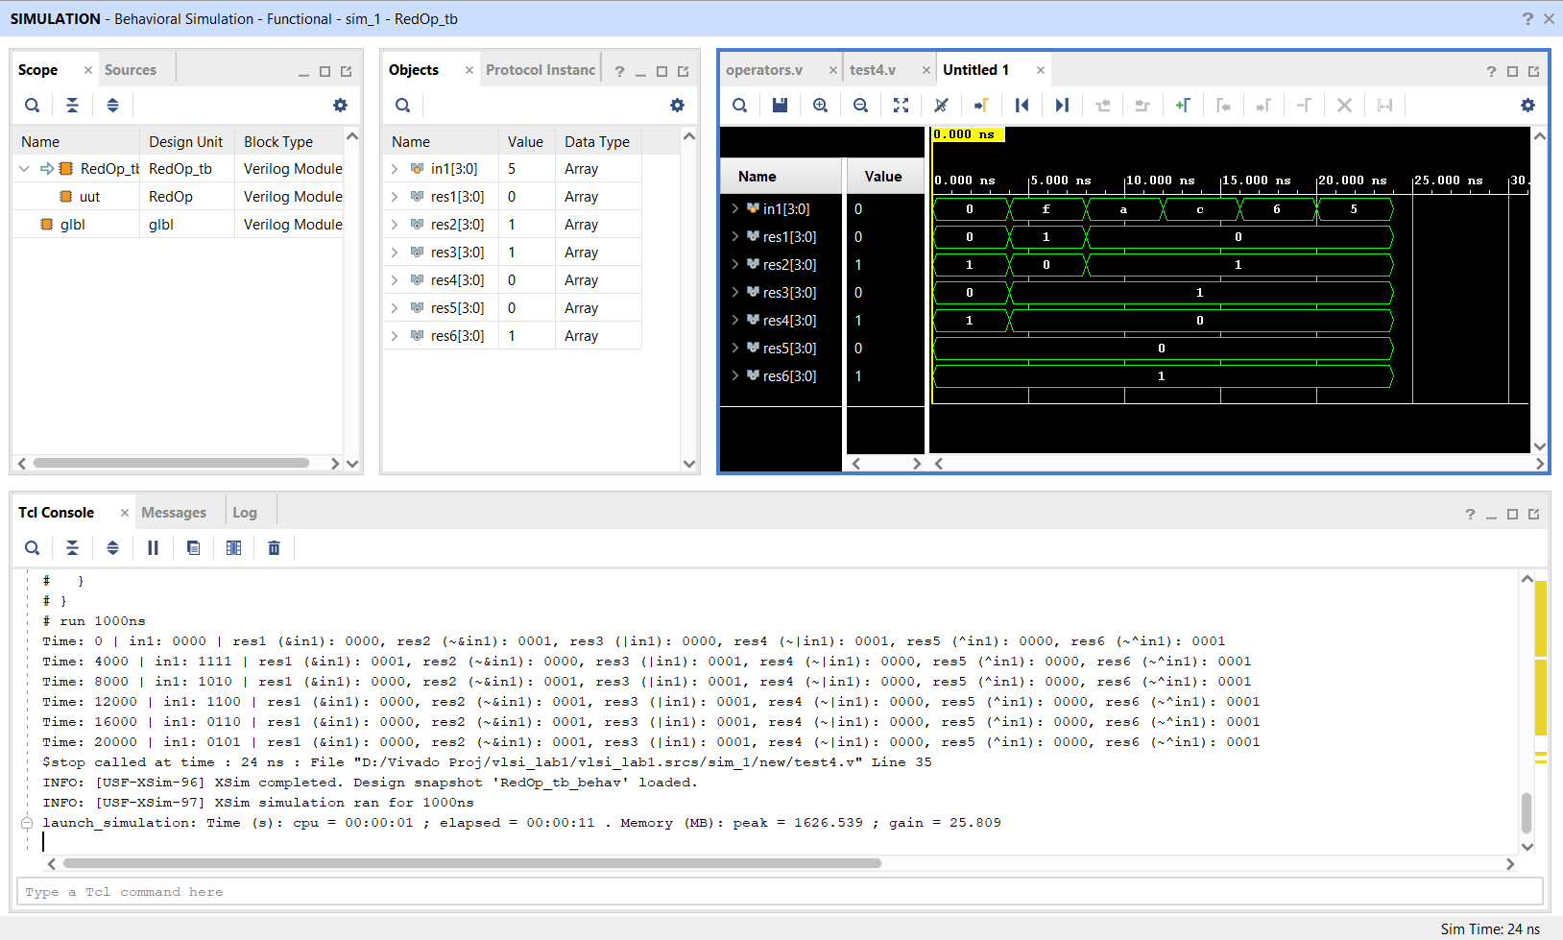
Results-Reduction

Slide 7
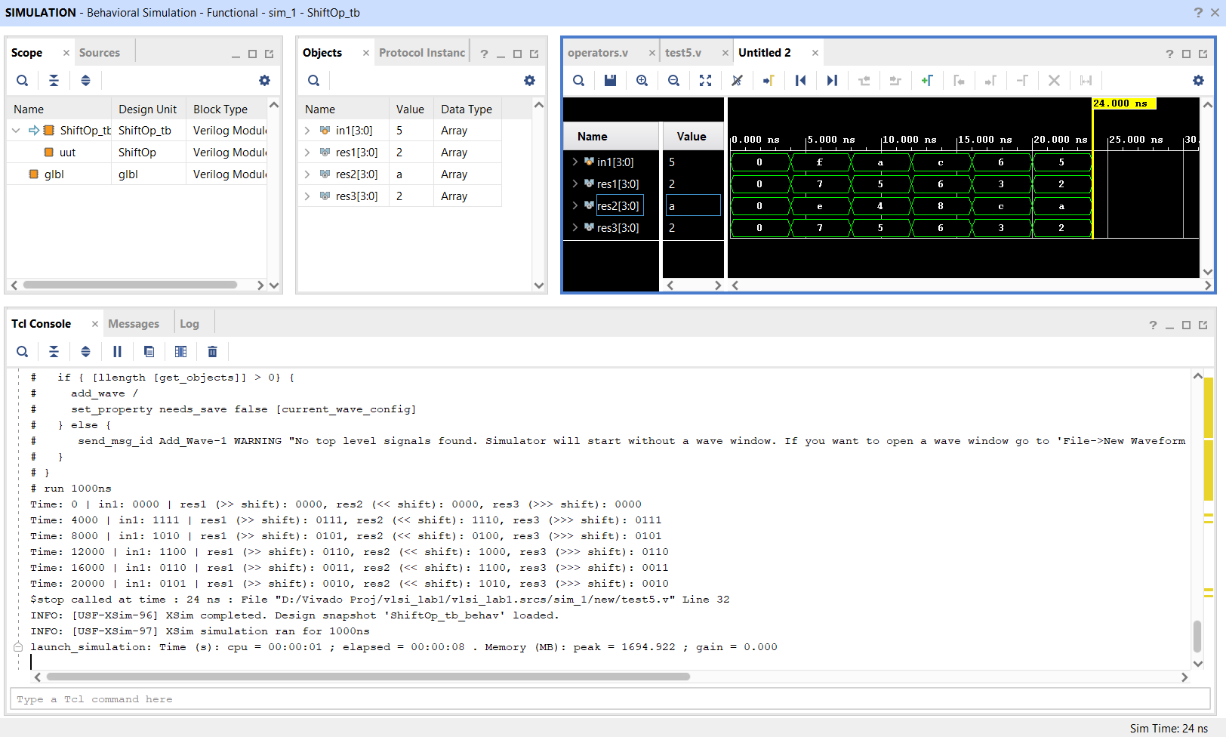
Results-Shift

Slide 8
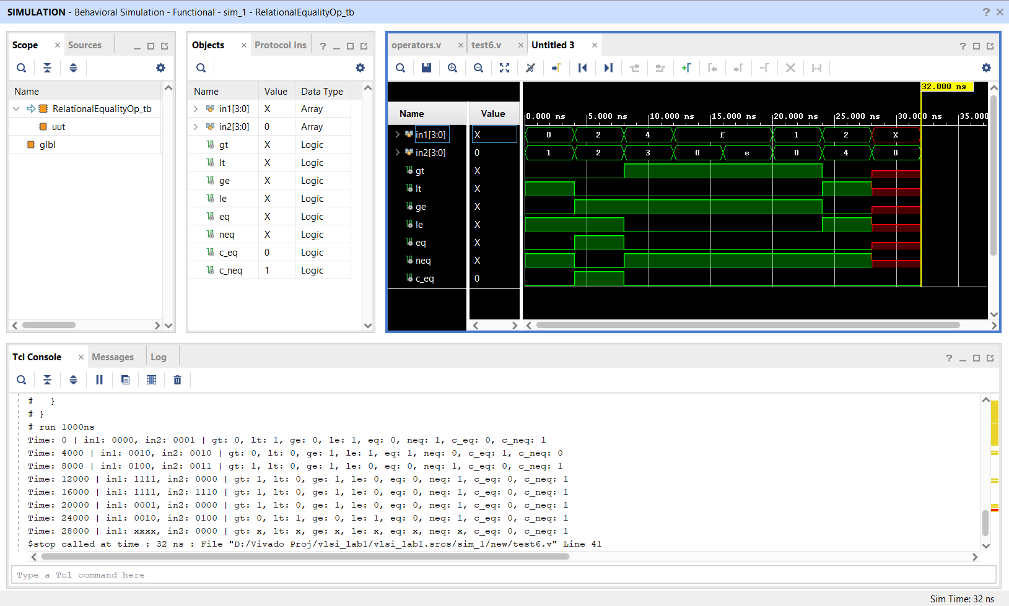
Results-Relational

Slide 9
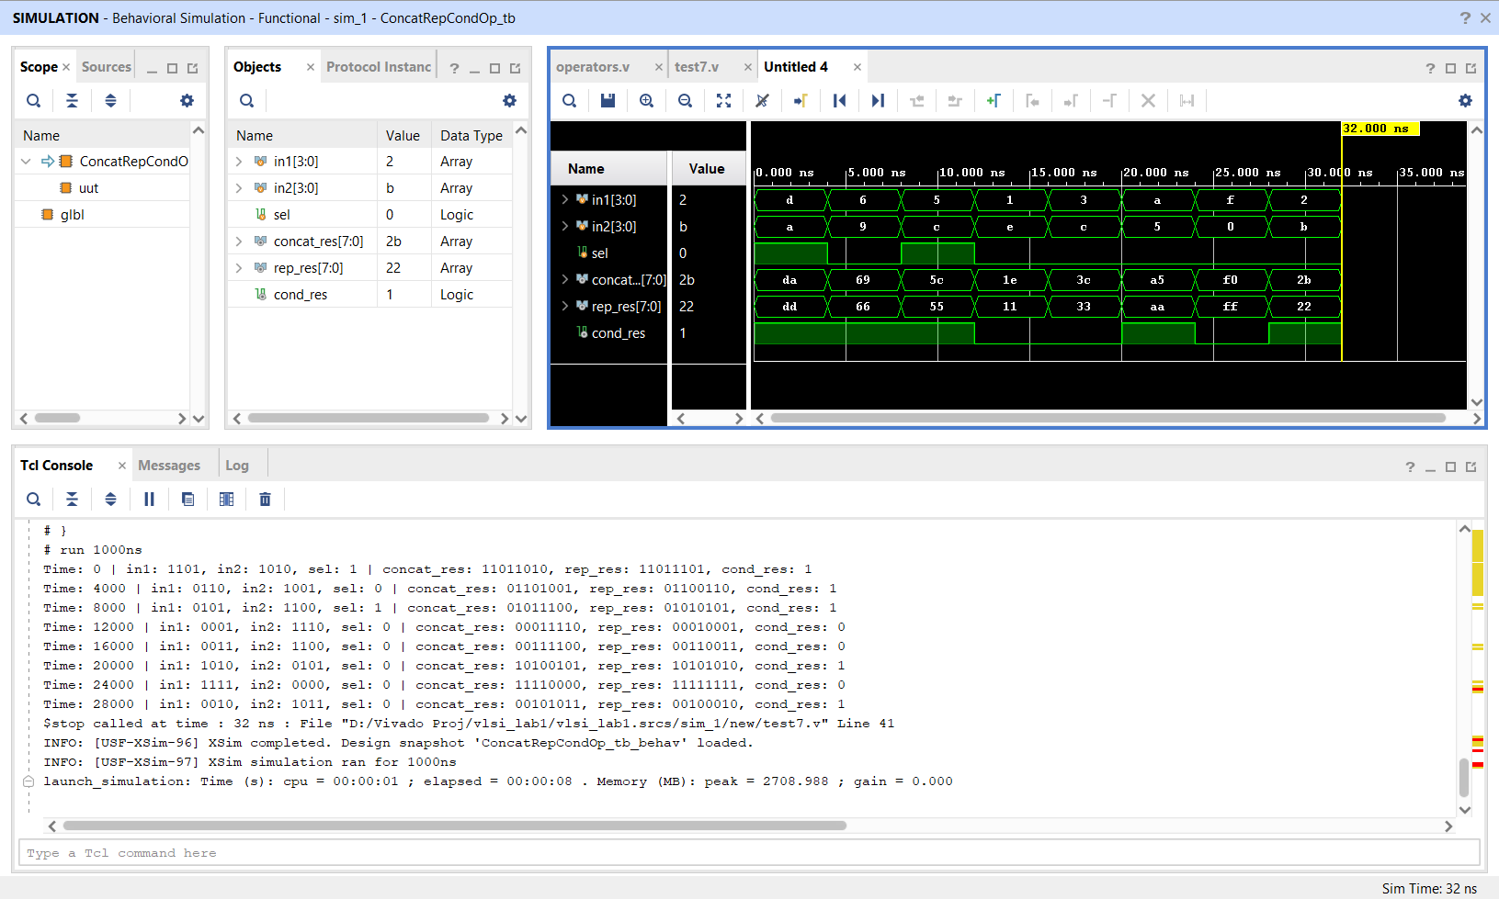
Results-Concatenation

Slide 10
Lab 2
Focused on efficient adder architecture
Task is to design:
16, 32 and 64 bit signed and unsigned Ripple Carry Adders
A 32-bit signed Redundant Carry Adder
A 64-bit hierarchical Carry Lookahead Adder
Then synthesize and compare LUTs, Power consumed and Delay
For synthesis, xc7z020clg484-1 board is chosen. Maximum delay path is noted

Slide 11
Synthesis Comparison
 | Ripple 16 bit |  | Ripple 32 bit |  | Ripple 64 bit |  | Redundant 32 bit | CLA 64 bit
 | Unsigned | Signed | Unsigned | Signed | Unsigned | Signed | Signed | Signed
LUT Count | 24 | 24 | 56 | 56 | 112 | 112 | 73 | 140
Total Power (in W) | 0.156 | 0.156 | 0.207 | 0.207 | 0.308 | 0.308 | 0.171 | 0.237
Maximum Delay Path (in ns) | Setup: 10.278 Hold: 2.106 | Setup: 10.278 Hold: 2.106 | Setup: 13.777 Hold: 2.106 | Setup: 13.777 Hold: 2.106 21.157 | Setup: 21.326 Hold: 1.796 | Setup: 21.326 Hold: 1.796 | Setup: 11.655 Hold: 2.120 | Setup: 11.782 Hold: 2.117
Conclusion:
CLA is the fastest adder Redundant adder is faster than ripple carry adder (32 bit)

Slide 12
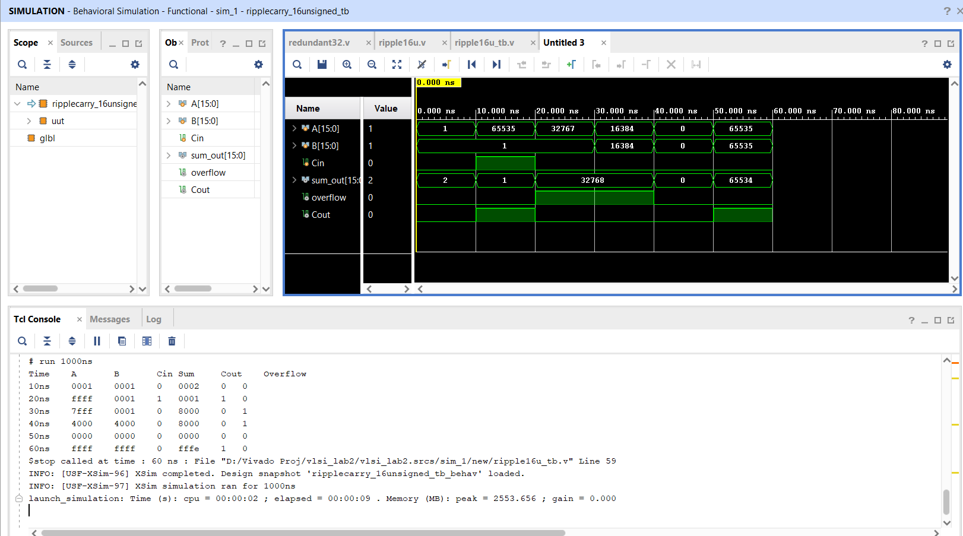
Results- Unsigned Ripple16-bit

Slide 13
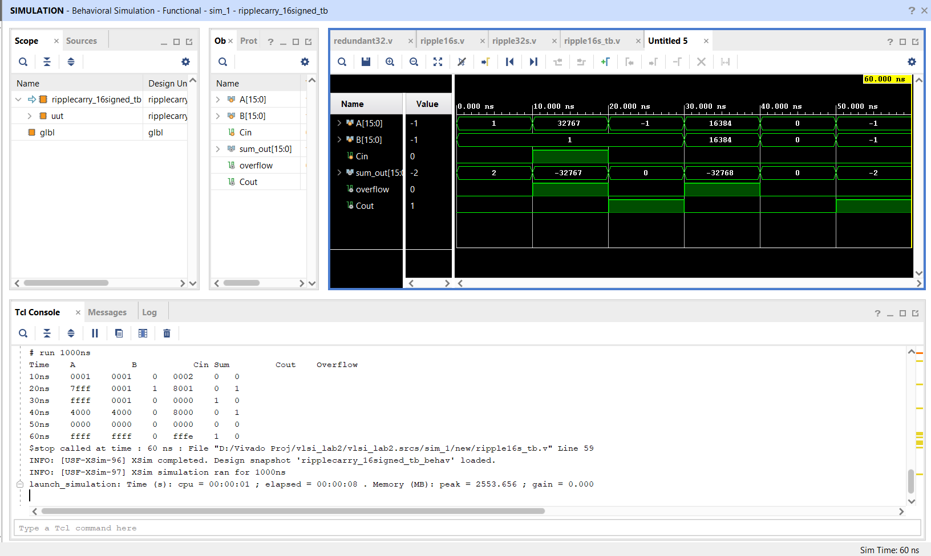
Results- Signed Ripple 16-bit

Slide 14
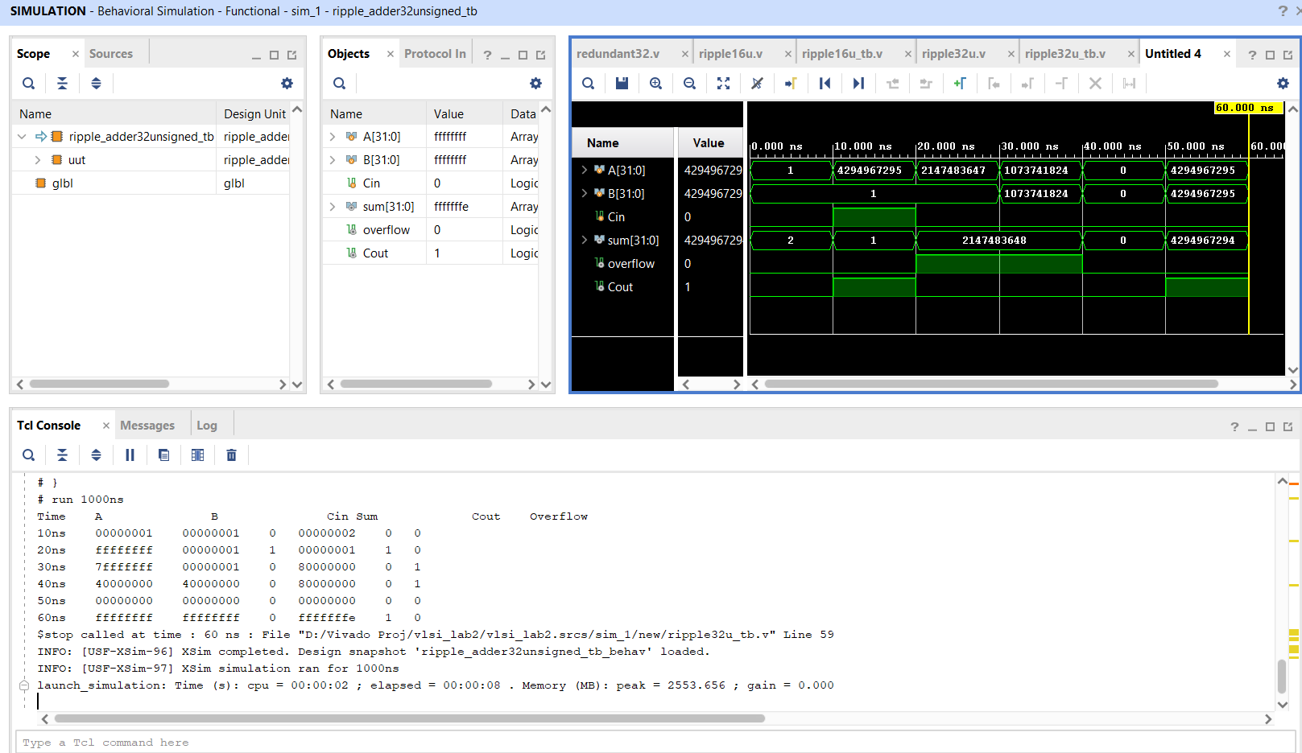
Results- Unsigned Ripple 32-bit

Slide 15
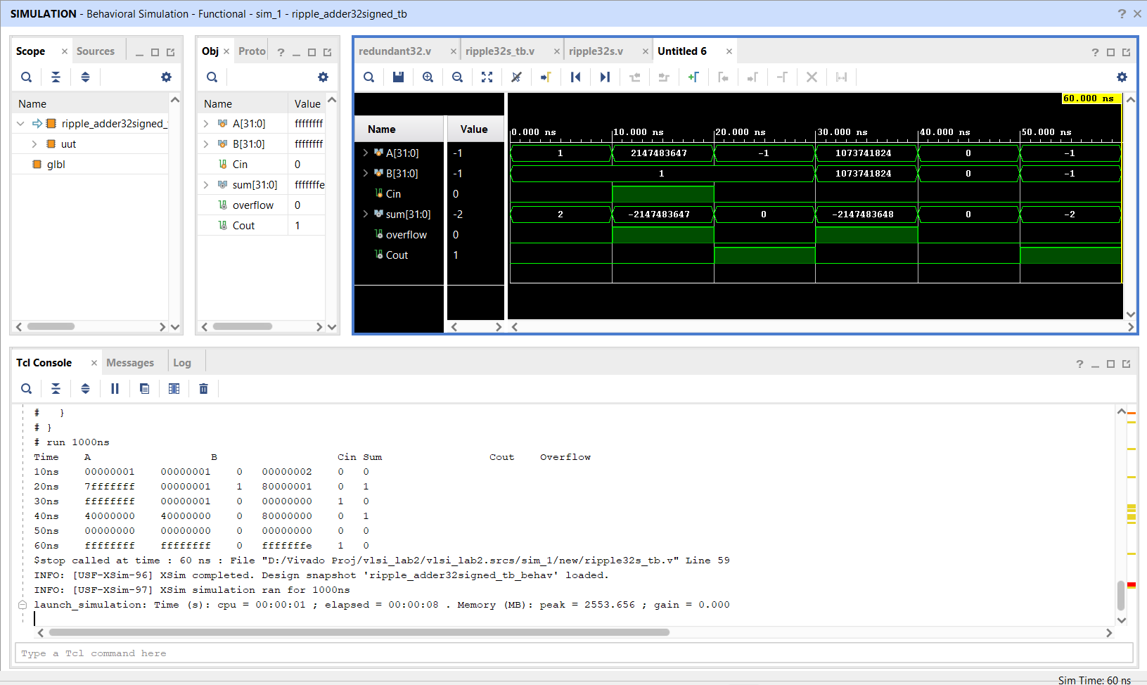
Results- Signed Ripple 32-bit

Slide 16
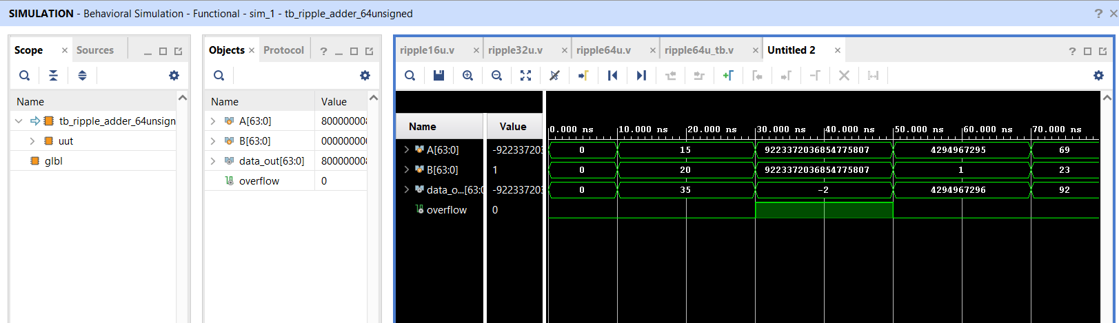
Results- Unsigned Ripple 64-bit

Slide 17
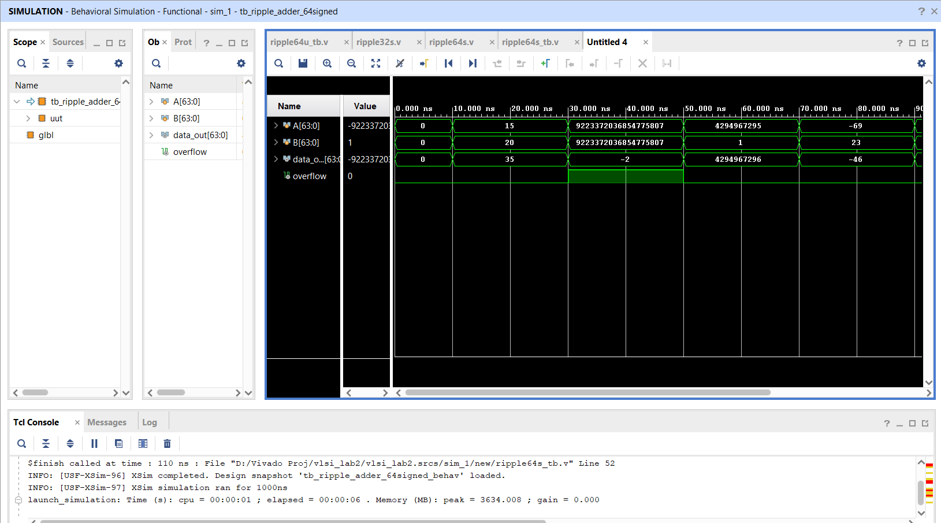
Results- Signed Ripple 64-bit

Slide 18
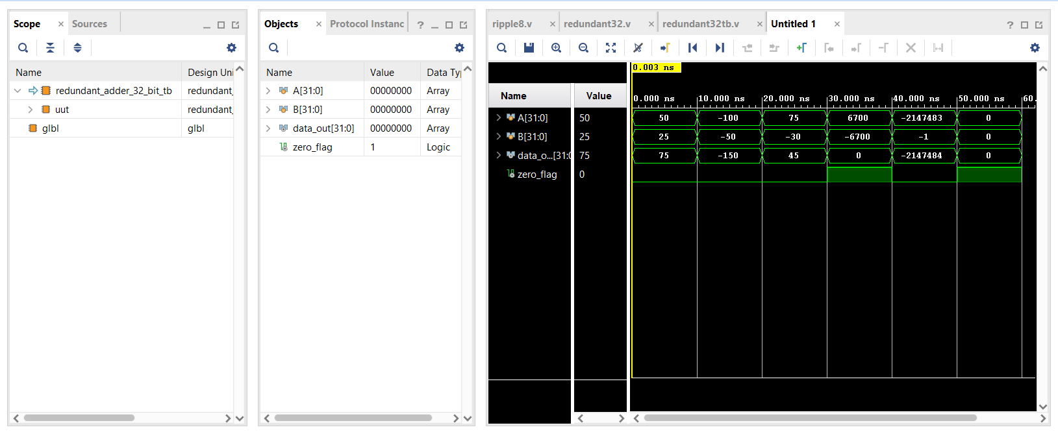
Results- Redundant 32-bit

Slide 19
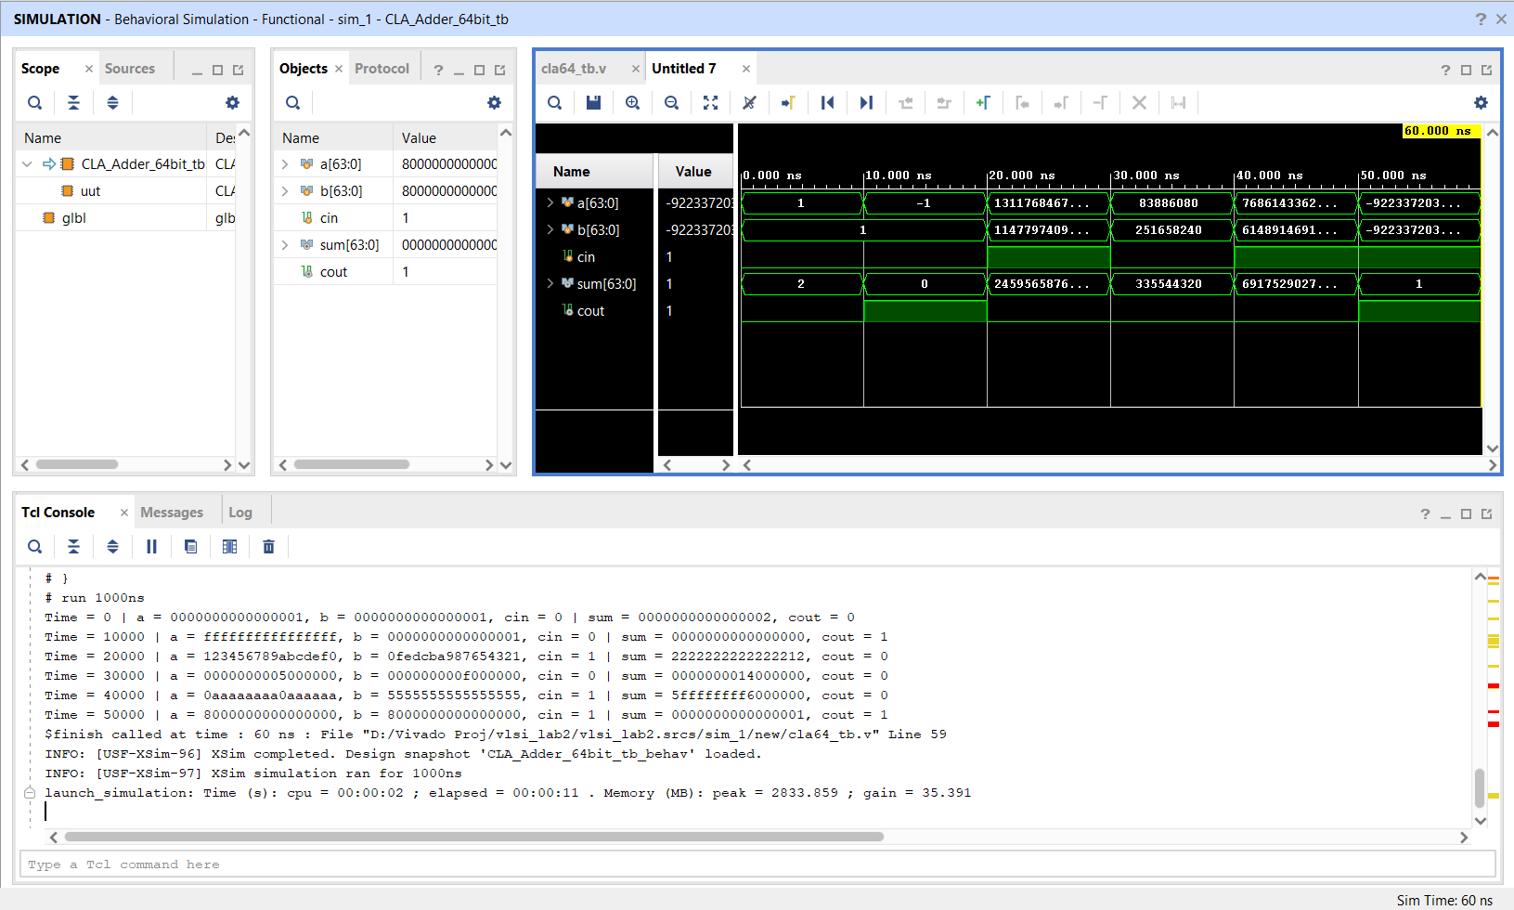
Results- Carry Lookahead 64-bit

Slide 20
Lab 3
Focused on 32-bit general purpose combinatorial shifter with left/right arithmetic/logical shift operations
Synthesis and record of LUTs, Power consumed and Delay
Shift type guide- 2-bit port ‘c’ is used to specify type of shift. 00: Logical Left shift 01: Arithmetic Left shift 10: Logical Right shift 11: Arithmetic Right shift
Remark: SAL and SHL are equivalent, but we have c[0] as control for L/A and c[1] for L/R

Slide 21
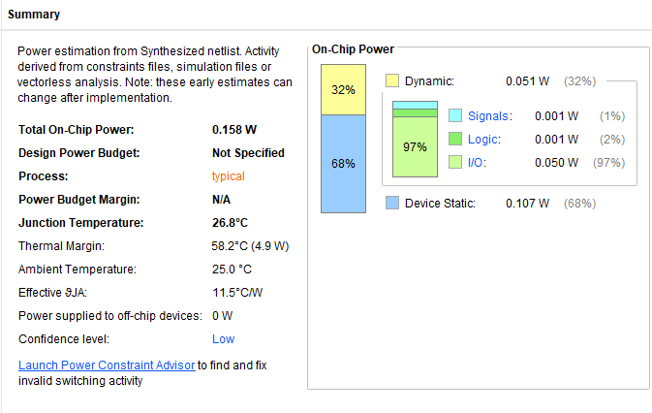
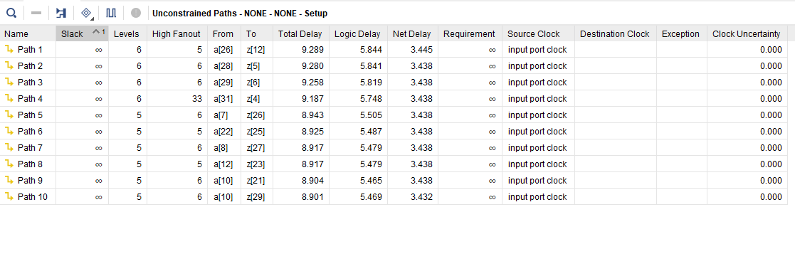
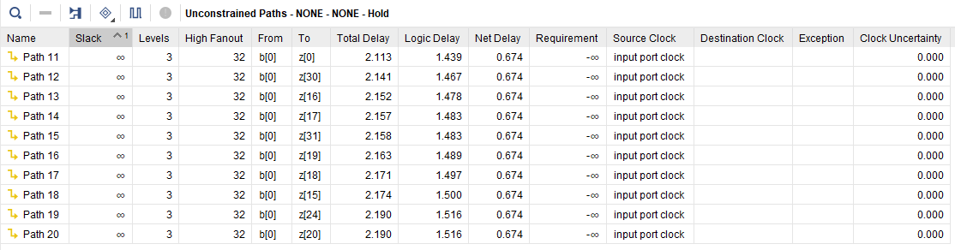
Synthesis – 163 LUTs

Slide 22
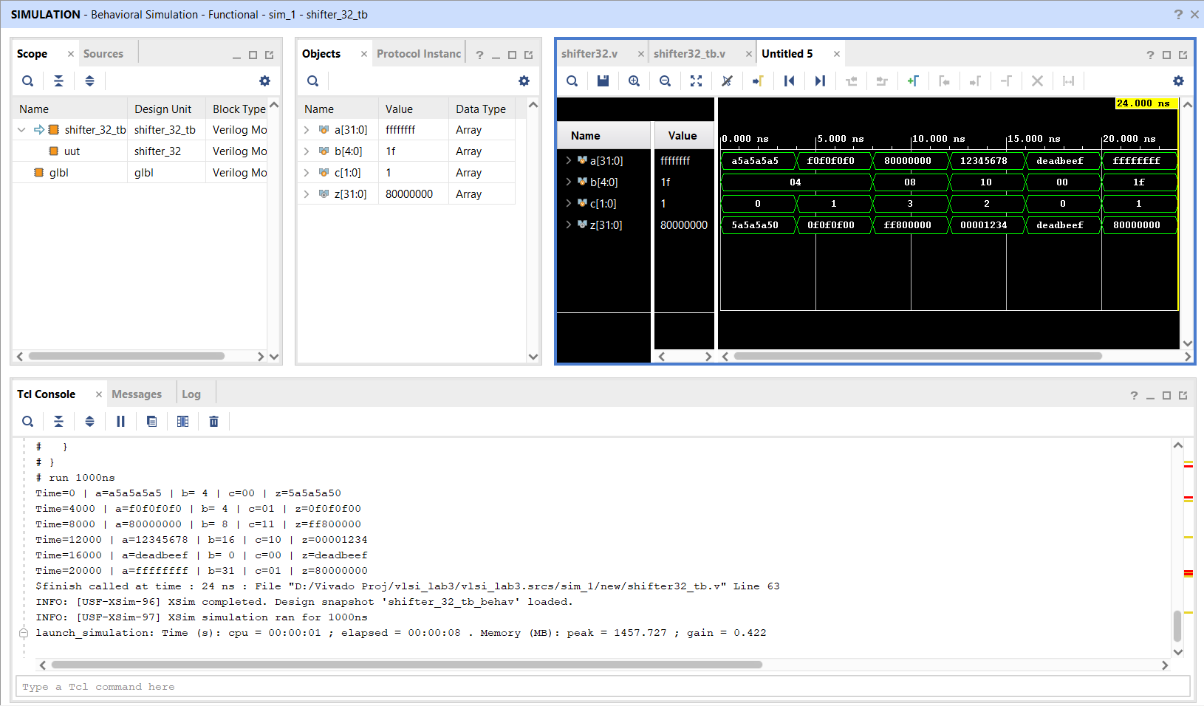
Results

Slide 23
Lab 4
Design a Moore FSM controller to control the appliances for room comfort as per specifications.
Given inputs are sensitive to temperature change.
Then synthesize for Xilinx FPGA (XC7Z020 CLG484-1) and characterize performance, complexity, delay and power.

Slide 24
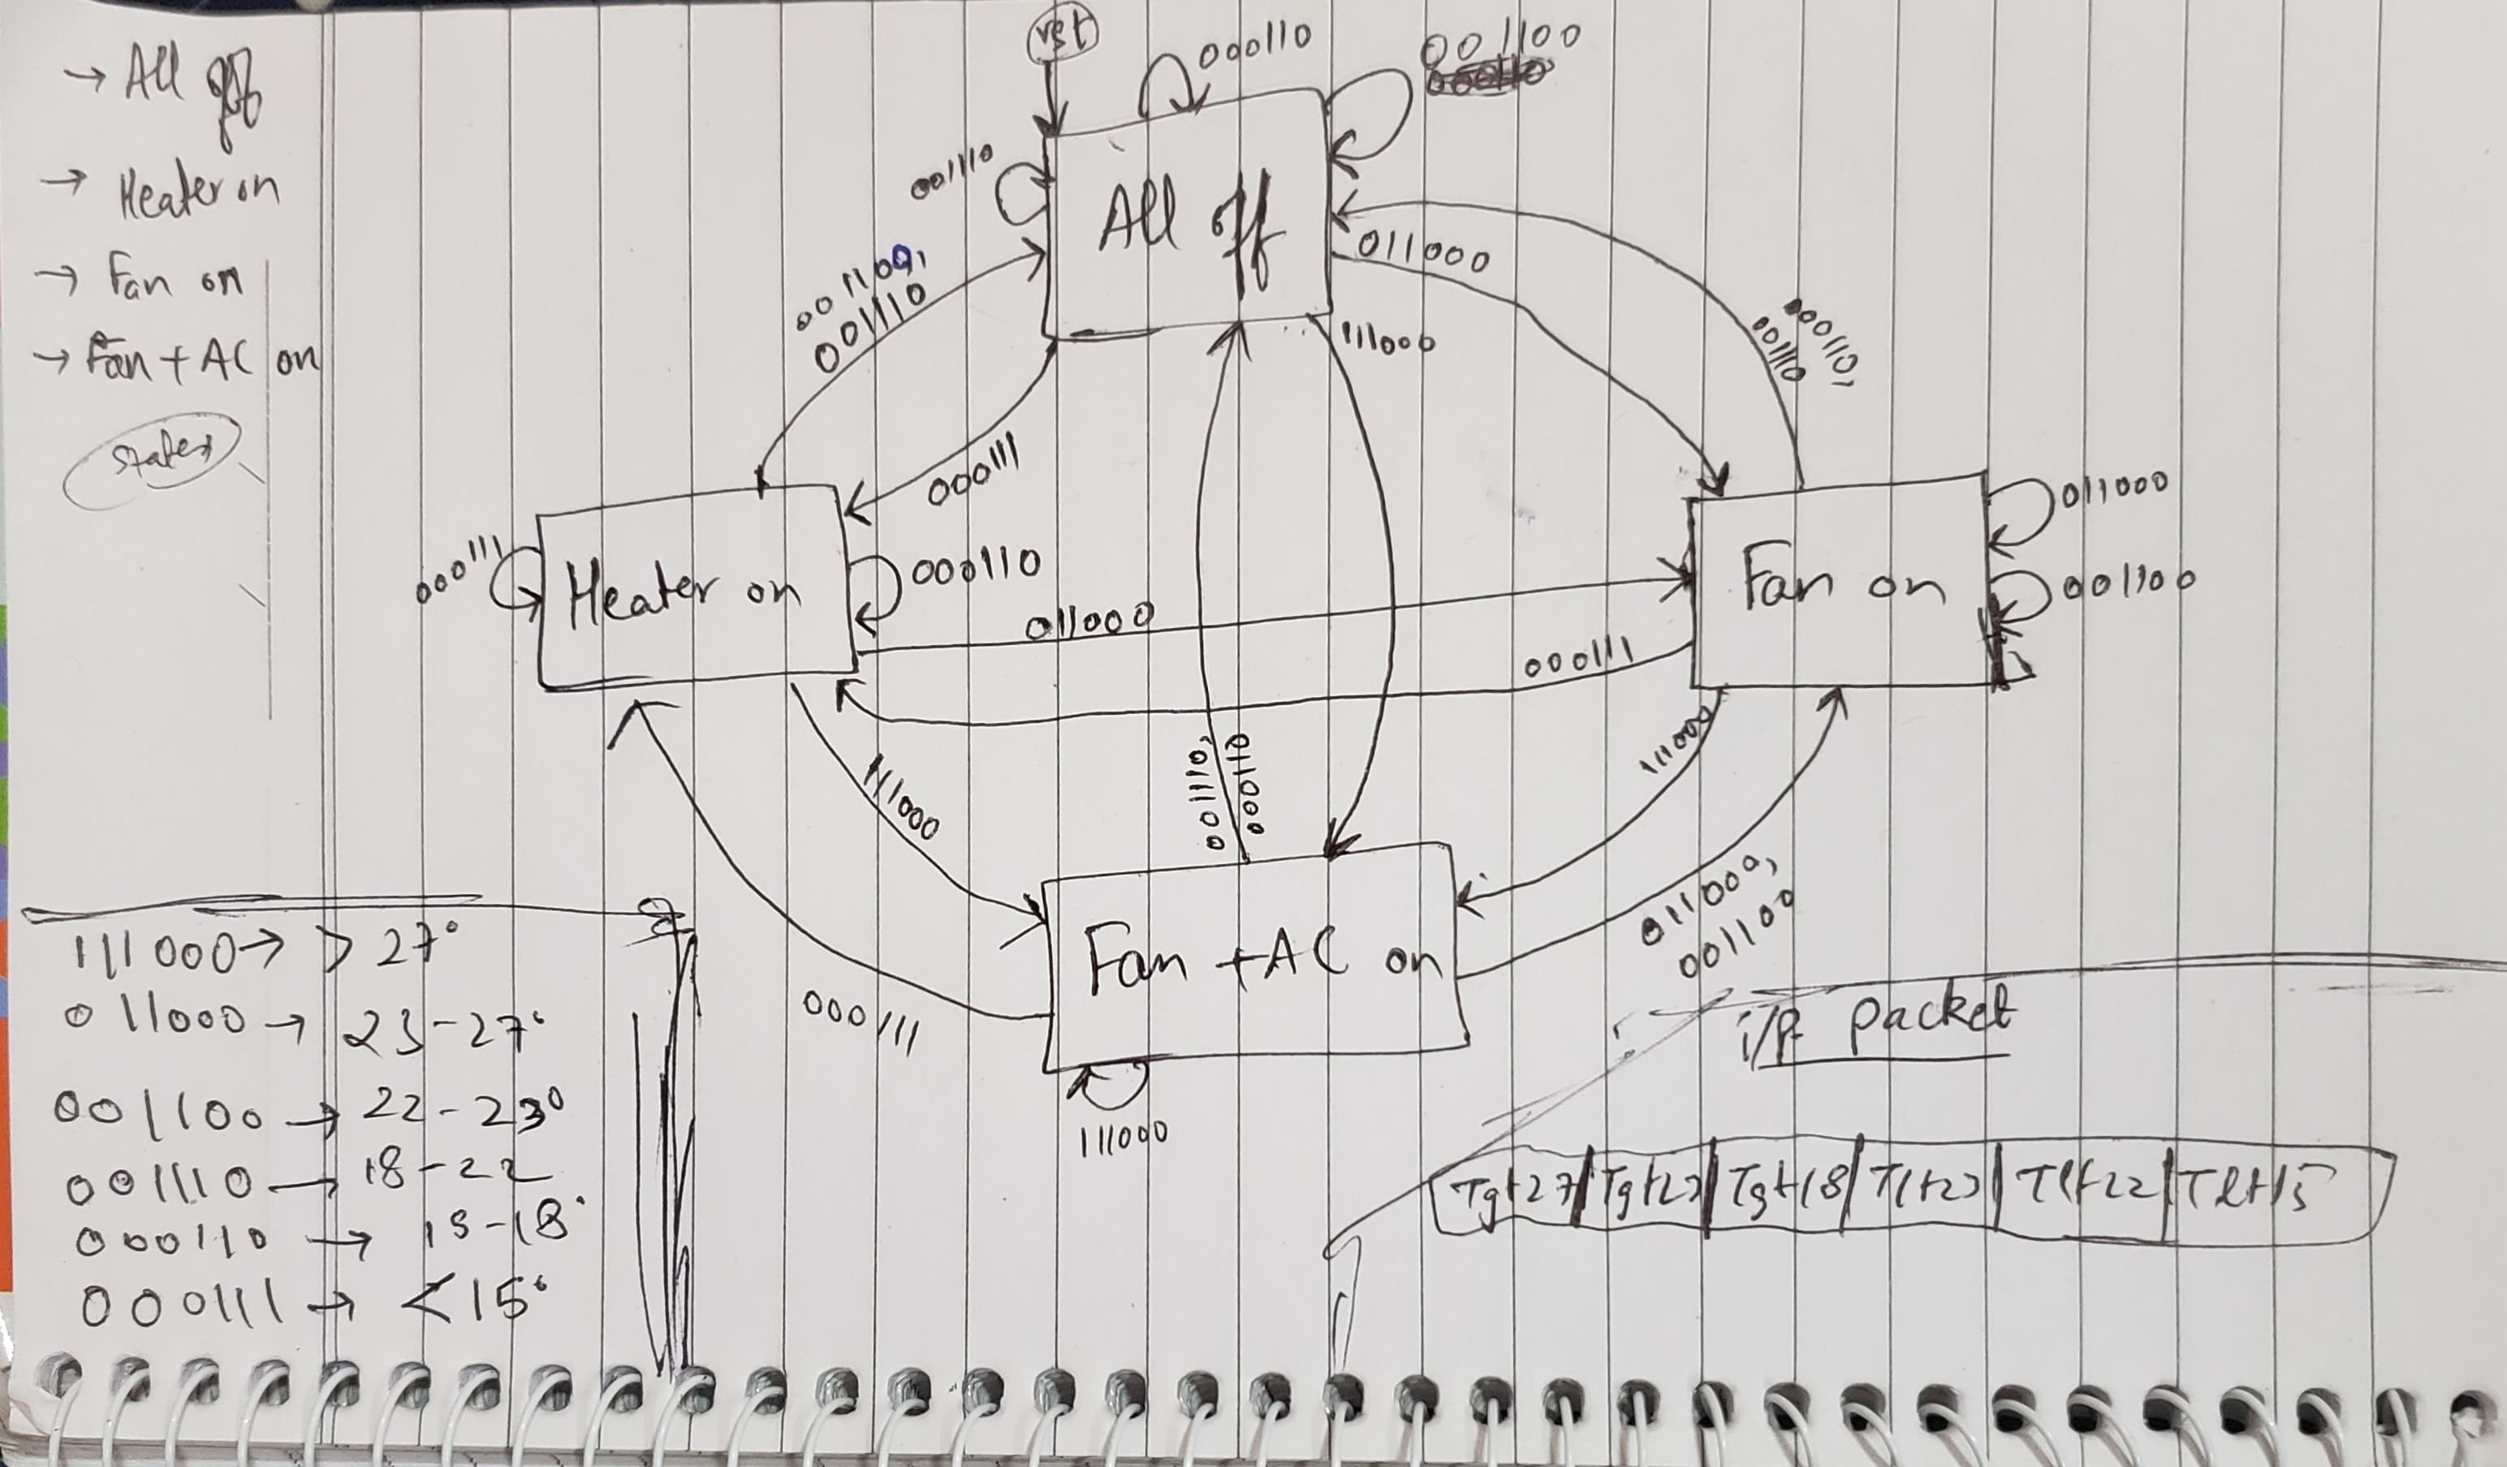
Moore FSM
o/p packet AC | Fan | Heater

Slide 25
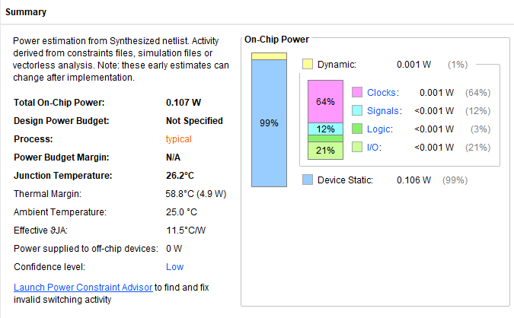
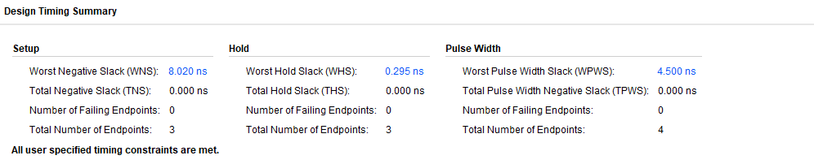
Synthesis – 8 LUTs & 3 FFs

Slide 26
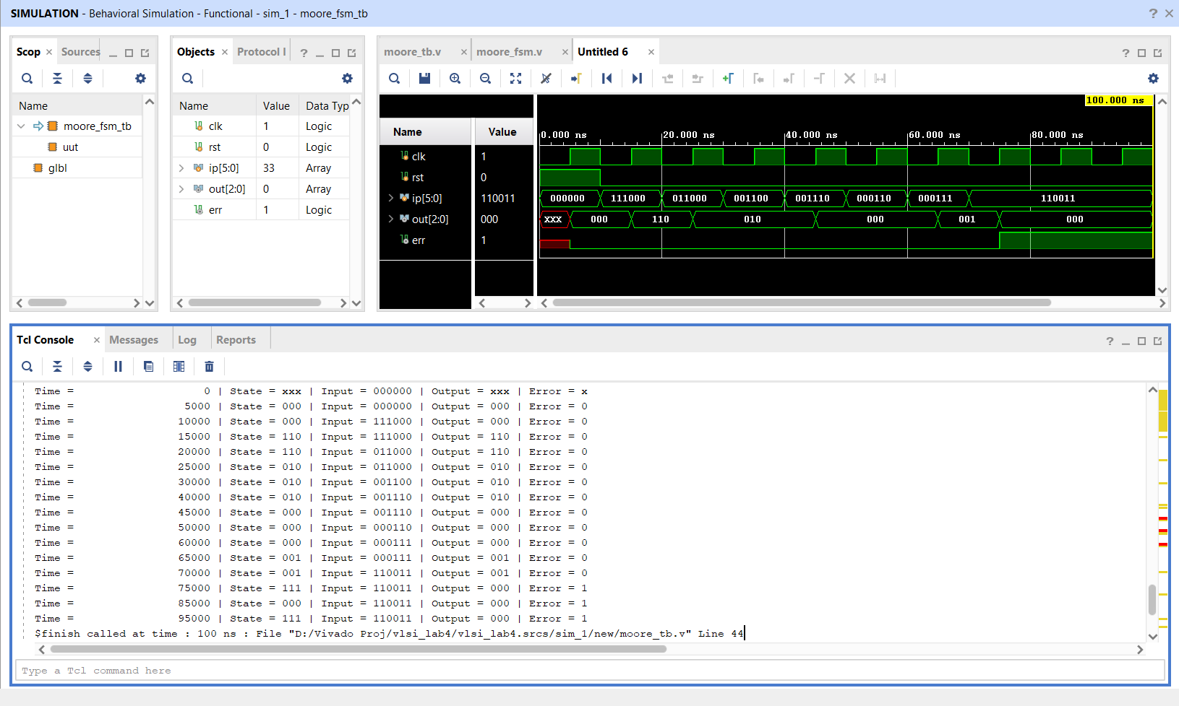
Simulation

Slide 27
Lab 5
Implemented CORDIC algorithm as a behavioral Verilog module. Simulation Only.
Testbench is created in a way to track convergence for 4 test angles- 0°, 30°, 45°, and 60°

Slide 28
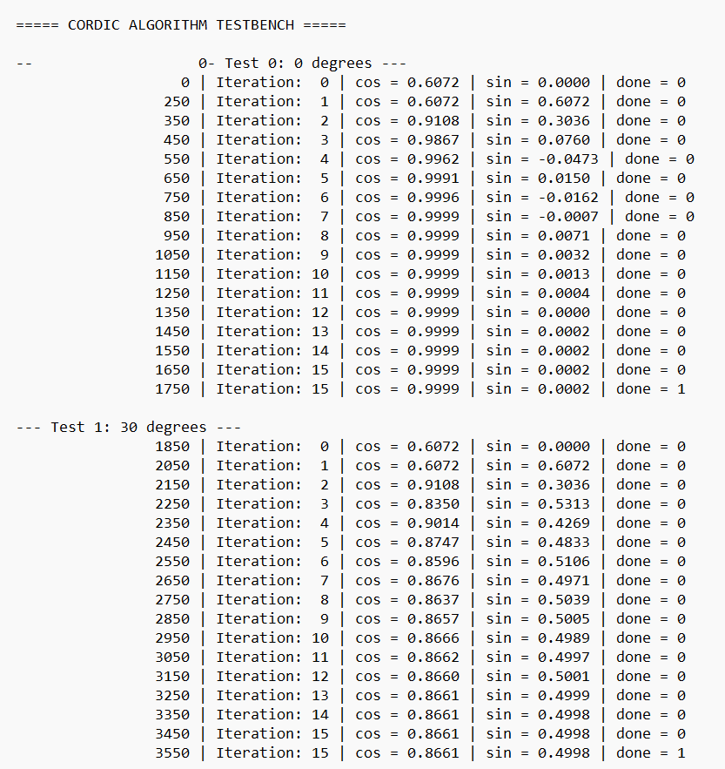
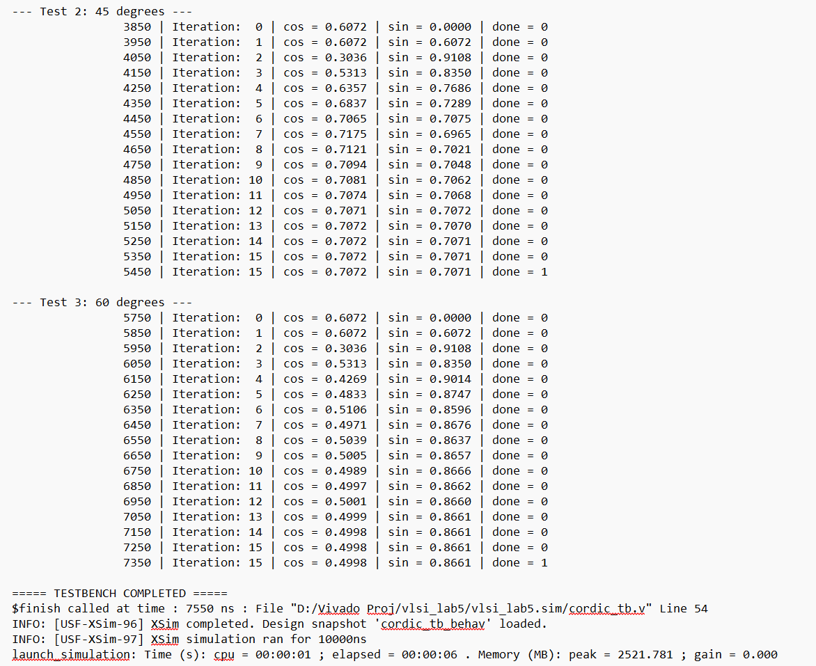
Results

Slide 29
MINi Project
Task is to simulate a program in a MIN processor (as described in the textbook ‘Microprocessor Logic Design’ by Nick Tredennick)
The processor is described using datapath components: control store, EU, instruction decoder, next state logic
The program is: ld r1, r7@
ld r2, (r7 + 15)@
ld r3, (r7 + 14)@
add r1, r2
sub r2, r3
st r3, (r7 + 1)@ #R3 stored into M[17]
Initialisations: R7=16, M[16]=248, M[31]=620, M[30]=1200
#R2=R1+R2; R1=248, R2=620; R2_new = 868
#R3=R2-R3; R3=1200; R3_new = -332

Slide 30
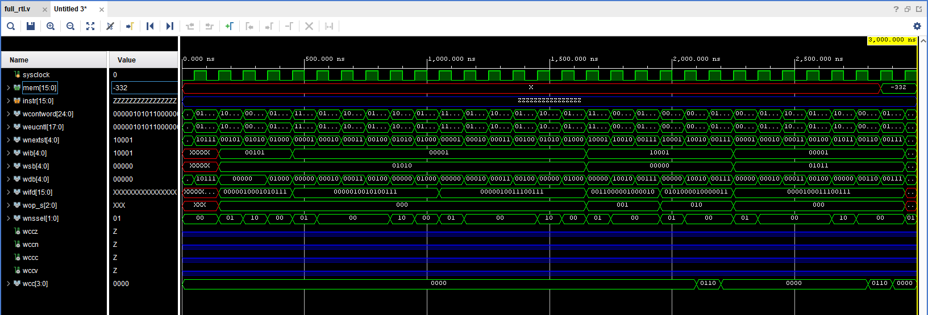
Simulation

Slide 31
Lab 7
To add a new instruction “AADD Rx, Ry” to the MIN processor developed earlier.
Memory config:
regfile [3] = 0;
regfile [4] = 10;
mem [10] = 4;
mem [11] = 6;
mem [12] = 10;
mem[13] = 0;
pc = 16’b0;

Slide 32
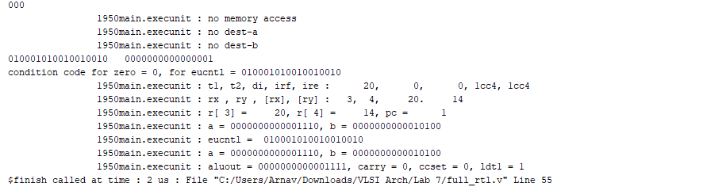
Results

Slide 33
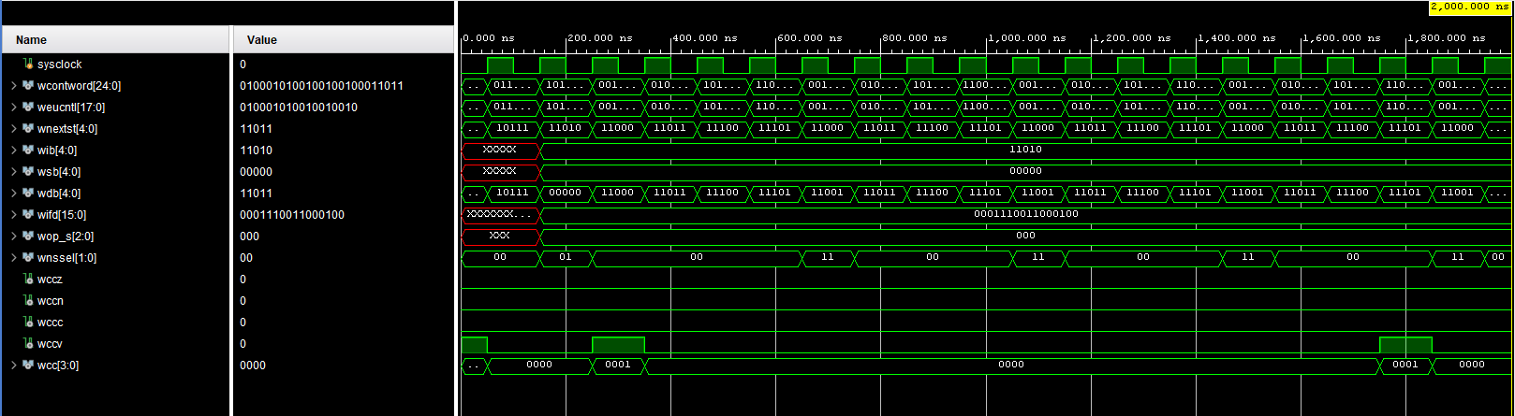
Results

Slide 34
Lab 8
To understand, simulate, synthesize and characterize the combinatorial logic of EXECUTE Stage of the 5-stage pipelined implementation of RISC-V (RV32I) ISA.

Slide 35
Synthesis Comparison
 | Exec
LUT Count | 361
Total Power (in W) | 0.268
Maximum Delay Path (in ns) | 27.668ns logic 7.229ns route 20.440ns

Slide 36
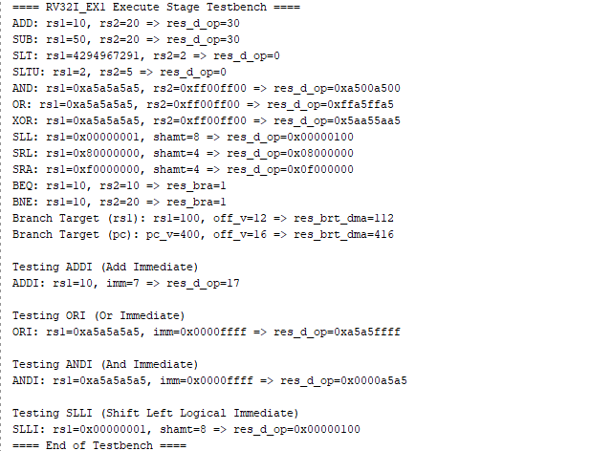
Results

Slide 37
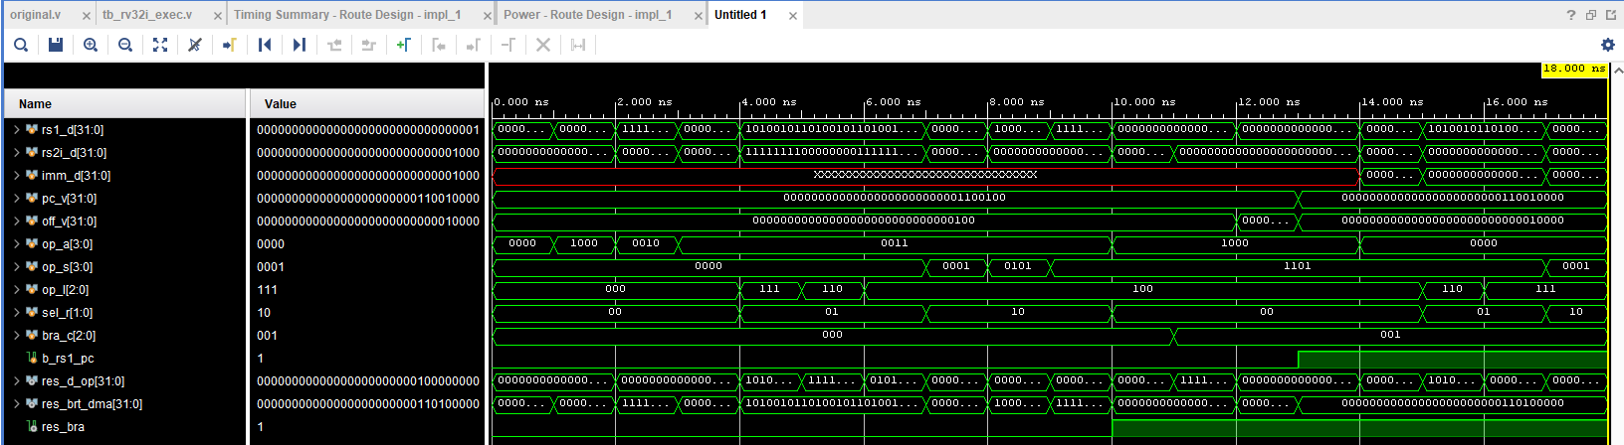
Results

Slide 38
Lab 9
To develop and test the function of the MEM stage in a 5-stage pipelined implementation of RISC-V RV32I instruction set using a behavioral Verilog model

Slide 39
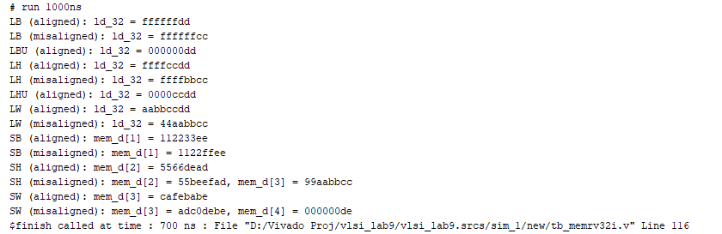
Results

Slide 40
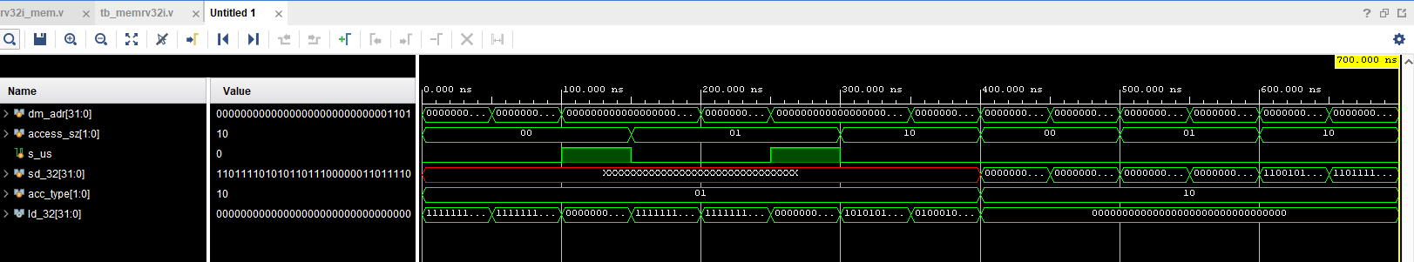
Results

